Slide 1

JavaScript Programming
Information Technology
Adding JavaScript to HTML

Slide 2


Slide 3
Adding JavaScript to HTML
There are two general ways to add JavaScript to HTML
Embedded script tag(s)
External JavaScript file(s)

Slide 4
Embedded JavaScript in HTML
JavaScript code is placed between open and closed script tags
Typically placed within the <head> tag
But can by placed within the body of the page
Gets loaded and executed where it resides in the HTML from the top down
We will see how this is important later in the course

Slide 5
Embedding JavaScript in HTML
<!DOCTYPE html> <html>
<head> <script>
let myPhoneNumber = ‘(506) 856-2280’;
alert(myPhoneNumber); </script> </head> <body>
<h1>A Web Page</h1> <p>A web page with embedded JavaScript</p>
</body> </html>
Embedded JavaScript in my HTML page.
Uses open and closed script tags

Slide 6
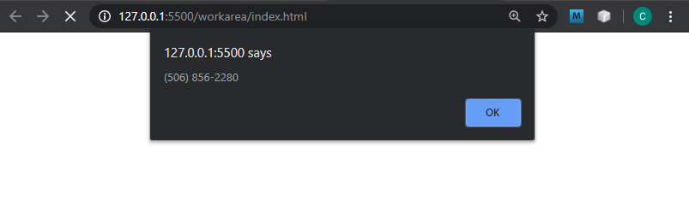
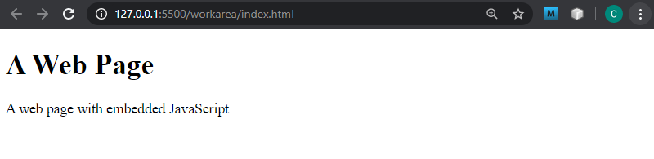
With alerts, page executes pauses until the Ok button is clicked

Slide 7
External JavaScript file in HTML
JavaScript code is placed in an external file with a .js extension
The JavaScript file is referenced in the html page with the script tag, setting the src attribute pointing to the desired .js file
We can use local .js files and remote .js files
For this course we will use local .js file (Stored in our project folders with our html files)
JavaScript code in external files do not use the script tag in the .js file(s)

Slide 8
External JavaScript file in HTML
<!DOCTYPE html> <html>
<head> <script src=“app.js”></script>
</head> <body>
<h1>A Web Page</h1> <p>A web page with external JavaScript</p>
</body> </html>
Script reference added with the script tag. Path to the local resource is within the script src attribute pointing to a file with .js extension

Slide 9
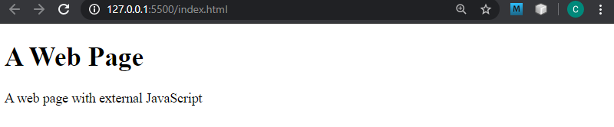
With alerts, page executes pauses until the Ok button is clicked

Slide 10
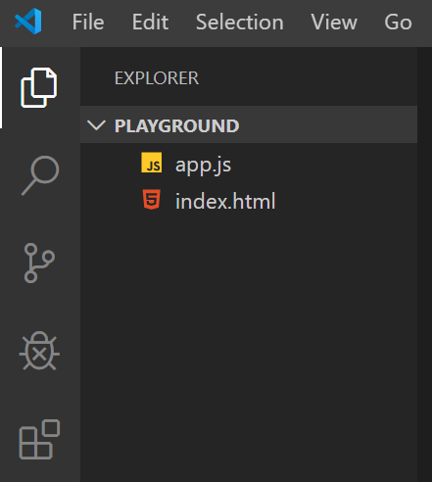
HTML Page and External JavaScript file app.js

Slide 11
<!DOCTYPE html> <html>
<head> <script src=“app.js”></script>
</head> <body></body></html>
HTML Page and JavaScript file in the same directory
src attribute set to file name

Slide 12
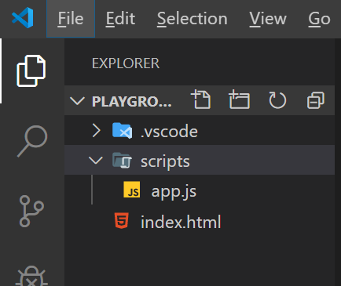
HTML Page and External JavaScript file app.js in a directory called scripts

Slide 13
<!DOCTYPE html> <html>
<head> <script src=“scripts/app.js”></script>
</head> <body></body></html>
src attribute set to the path to the file

